Slide 1

QUERY TRAFFIC VIOLATIONS DATABASE SYSTEM
徐铂凯 MICHAEL 1730014072
李欣岳 ERIKA 1730026048
林彦志 LARRY 1730026065

Slide 2

CONTENT
Introduction
Home Page
Registration & query
Manage & recharge
Conclusion

Slide 3
Introduction

Slide 4

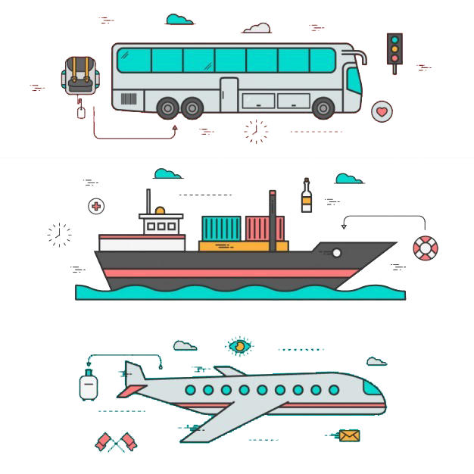
Introduction
Some uncivilized behaviors like throwing trash out the window happen from time to time.
Many of the systems currently only focus on the offensive record such as over-speed, but for those uncivilized behaviors, these kind of systems seldom record.
According to World Health Organization, the deaths related to the road traffic reach
1.35 million per year in the global range. And only in China, 250 thousand people die each year due to the traffic accident.

Slide 5
introduction
Not only can show the violation data but also the uncivilized behavior as well
Give the penalty as well as give the lessons and courses

Slide 6
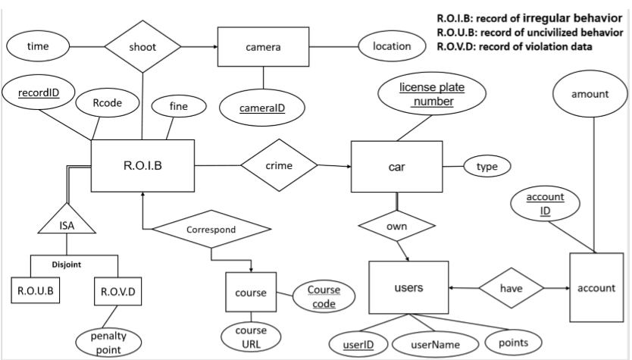

ER model

Slide 7
Functional dependency
ROIB (rid, Rcode, fine) have two functional dependency:
F= { recordID → Rcode, fine Rcode →fine}
This is not in 3rd normal form.
R2 = record = {recordID, Rcode }
R1 = ROIB = { Rcode, fine}

Slide 8

Schema
ROUB (Rcode, fine)
ROVD (Rcode, fine, penalty_point)
Camera (cameraID, location)
Car (LicensePlateNumber, Type)
User (userID, userName, points)
Account (accountID, amount)
Course (Course_code, CourseURL)
Correspond (Rname, Course_code )
Shoot (recordID, cameraID, date)
Crime (recordID, license plate number)
Own (license plate number, type, userID)
Have (userID, accountID)
Record(recordID, Rcode )

Slide 9
Functional dependency
Rcode → fine
Rcode→ fine, penalty_point
cameraID→ location
LicensePlateNumber→Type
userID → userName, points
accountID → amount
Course_code → CourseURL
Rcode → Course_code
recordID → cameraID, date
recordID → license plate number
license plate number → type, userID
userID → accountID
recordID→Rcode

Slide 10
Home page

Slide 11
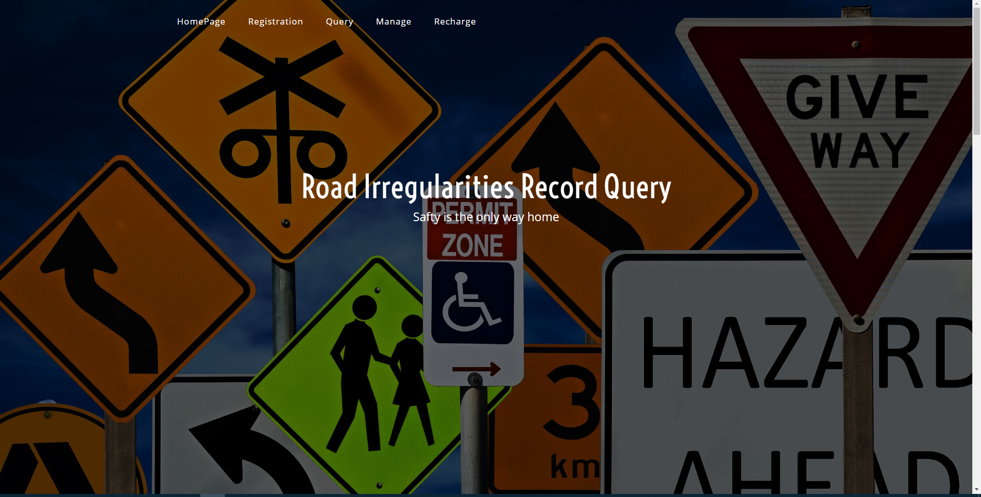
Home page

Slide 12
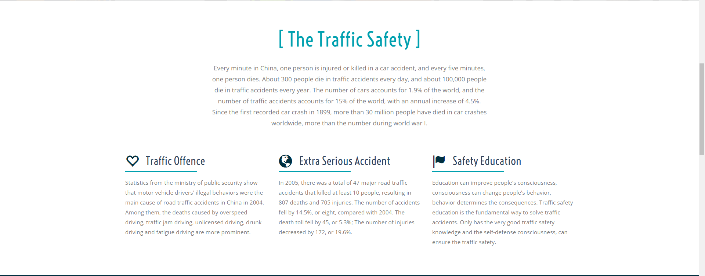
Home page

Slide 13
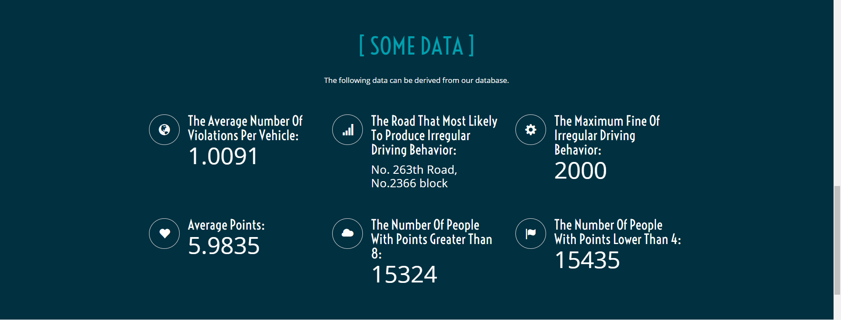
Home page

Slide 14
Home page
Find the average number of violations per vehicle
SELECT AVG(number)
FROM (SELECT COUNT(recordID) AS number
FROM Crime
GROUP BY LicensePlateNumber) AS N
Find the road that most likely to produce irregular driving behavior
SELECT location
FROM Camera
WHERE Camera.CameraID IN(
(SELECT CameraID
FROM Shoot
GROUP BY(CameraID)
HAVING COUNT(recordID)=(
SELECT MAX(number)
FROM (
SELECT CameraID,count(recordID) AS number
FROM Shoot
GROUP BY(CameraID))AS N1)))
Find the maximum fine of irregular driving behavior
SELECT MAX(fine)
FROM ROVD
Find average points of the users
SELECT AVG(points)
FROM Users
Find the number of people with points greater than 8
SELECT COUNT(userID)
FROM Users
WHERE points>8
Find the number of people with points lower than 4
SELECT COUNT(userID)
FROM Users
WHERE points<4

Slide 15

Home page

Slide 16
Registration & query

Slide 17
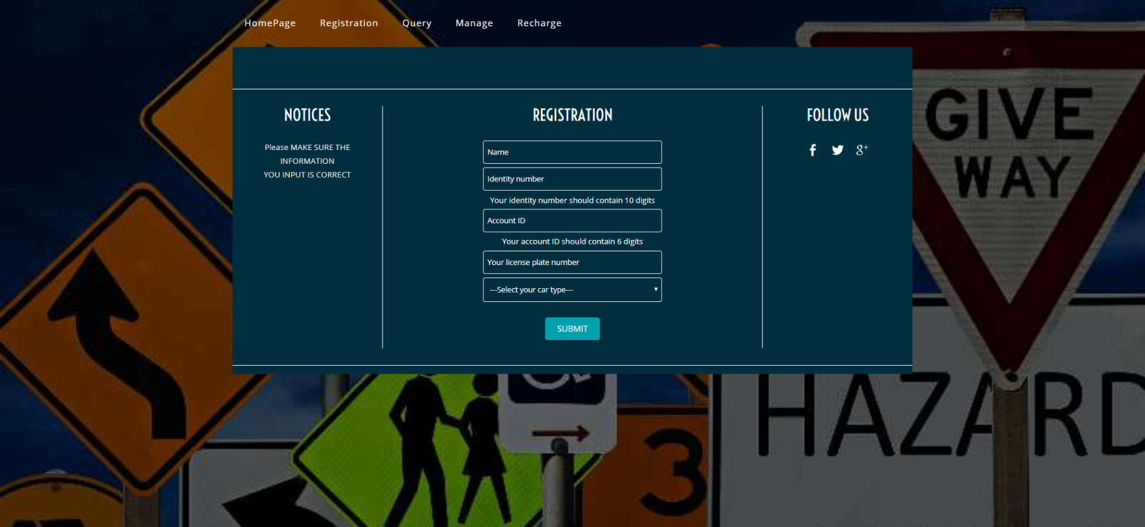
Registration
When a new user wants to use our database system, he or she must register first.
The new user should
input their name,
Identified ID, account ID,
license plate
Number and choose the
car type.

Slide 18
SQL For Registration
INSERT INTO Car (LicensePlateNumber,Type)
VALUES ('$plateNum','$carType');
INSERT INTO Own (LicensePlateNumber,type,userID)
VALUES ('$plateNum','$carType','$userID');
INSERT INTO Account (accountID,amount)
VALUES ('$accountID',0);
INSERT INTO Have (accountID,userID)
VALUES ('$accountID','$userID');

Slide 19
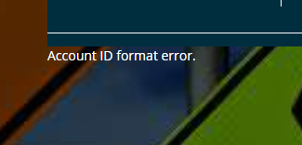
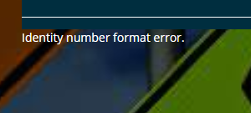
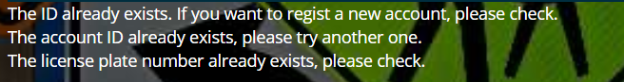
SQL For Registration
In addition, in order to avoid multiple registrations as well as inputting the incorrect format, we add some protection mechanisms in our system.
select *
from Users
where userID = '$userID‘
select *
from Account
where accountID = '$accountID‘
select *
from Car
where LicensePlateNumber = '$plateNum

Slide 20
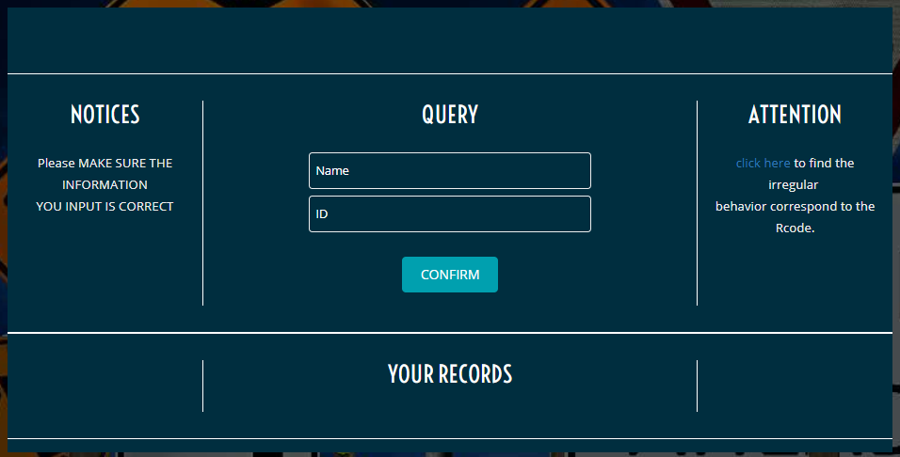
Query
Also, we can check whether a car has some irregular record by inputting your name and userID

Slide 21
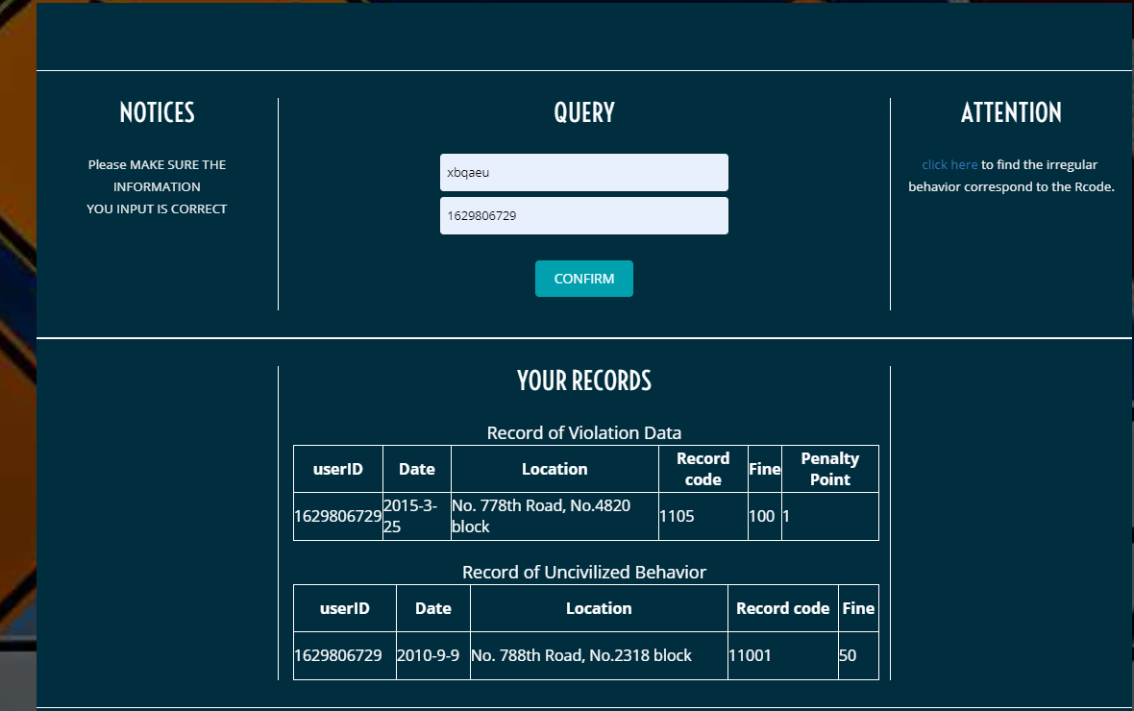
Query
After getting the result, you can click here to find the details about your record based on the Record code

Slide 22

SQL For Query
SELECT userID, date, location, Record.Rcode, ROVD.fine, ROVD.penaltyPoint
FROM Users natural join Own natural join Crime natural join Shoot
natural join Camera natural join Record natural join ROVD
WHERE userID = '$userID' and userName = '$nameValue‘
SELECT userID, date, location, Record.Rcode, ROUB.fine
FROM Users natural join Own
natural join Crime natural join Shoot natural join Camera
natural join Record natural join ROUB
where userID = '$userID' and userName = '$nameValue'
Notes:
aaa
9876543210
123456
A2C765
xbqaeu
1629806729
210991
C3F774

Slide 23
Manage & recharge

Slide 24
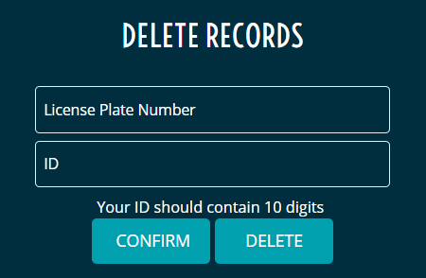
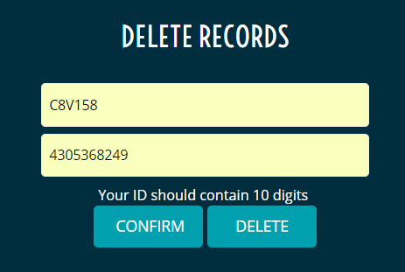
Manage
Two main functions: querying and deleting records
Information needed:
License plate number
Your ID number
query
delete

Slide 25
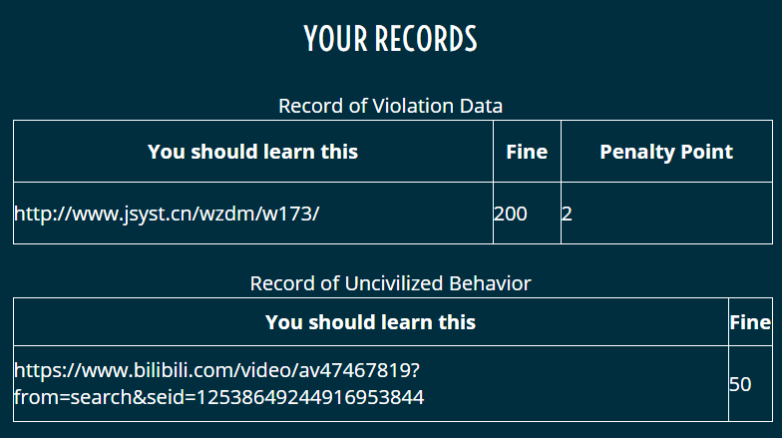
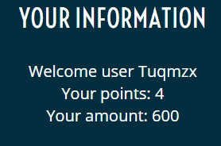
Manage - Query
Punishment for your irregular behavior records :
Relevant courses you should take
Fine
Penalty points (just for violation data records)
Personal information:
Name
Remaining points
Balance

Slide 26
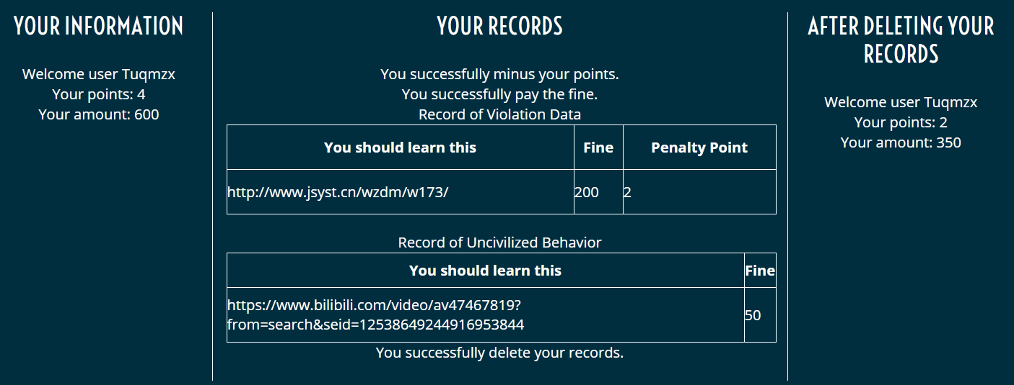
Manage – Delete
personal information BEFORE deleting
personal information
AFTER deleting
records that you delete
Notices: You successfully minus your points/ pay the fine/ delete your records

Slide 27
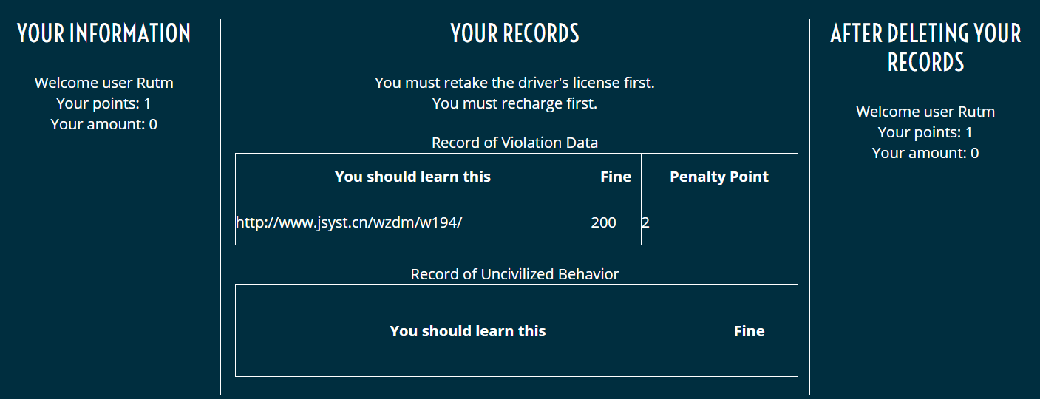
Manage – Delete
personal information BEFORE deleting
personal information
AFTER deleting
records that you delete
Notices: You must retake the driver’s license first / recharge first
Notes:
Successful
C3F774 1629806729
C3B444 1304926099
Not enough
C3E766 4181491037

Slide 28
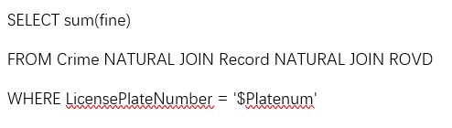
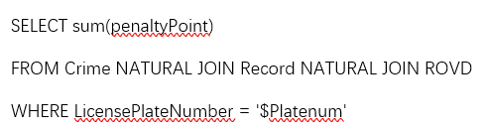
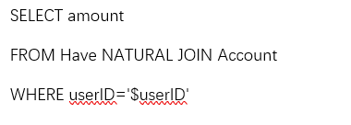
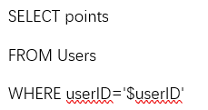
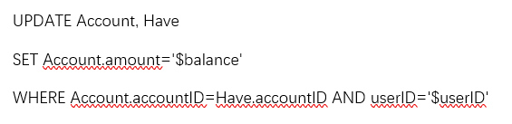
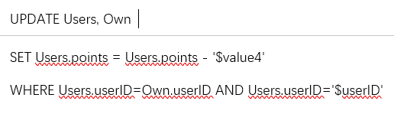
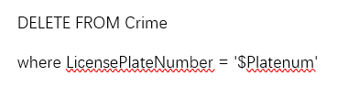
SQL For Manage
Notes:
Successful
C3F774 1629806729
C3B444 1304926099
Not enough
C3E766 4181491037

Slide 29
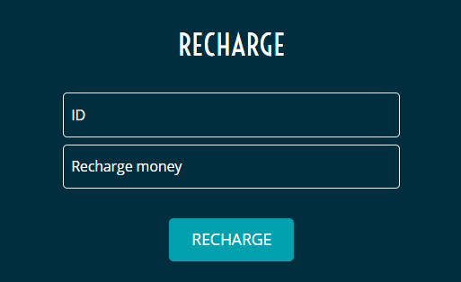
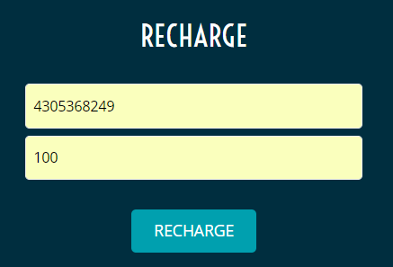
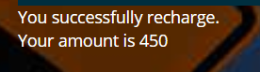
Recharge
Recharge your amount when the balance is insufficient
Notice:
You successfully recharge
The current amount of your account
Information needed:
ID number
Recharge money number
Notes:
2713828397

Slide 30
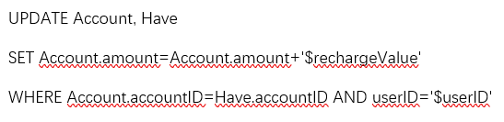
SQL For Recharge
Notes:
2713828397

Slide 31
Conclusion

Slide 32
Difficulties
PHP and html are hard since we are not familiar with them.
How to convert user-entered content on the webpage to a part of the SQL statement
SQL code, especially Update

Slide 33
Future
The situation in real life is more complex than we image. It still need to test more.

Slide 34
Safety is the only way home.

Slide 35
Thanks for listening!!!

